Slide 1
Creating An Effective Development Environment
August 15, 2019

Slide 2

Our team of software engineers and computational scientists are here to help you realize your software vision. The CodeWorks team has knowledge in many areas including, but not limited to requirements development, software infrastructure, web and mobile development, UI development, scientific computing, and software engineering.

Slide 3
Overview
The terminal
A Linux-like environment on Windows
Unix Philosophy
Terminal tools + extensions
Scripts, automation, aliases
Choosing a text editor
Brief history of text editors
How to choose an editor
General environment setup tips
Beyond the terminal + text editor
Syncing settings across multiple machines
Theming + pretty colors

Slide 4
The terminal
Your Best Friend,

Slide 5
Terminal Tools : Linux on Windows
Windows 7
Cygwin, MSYS2, Git Bash, CMDER
I use MSYS2 in VSCode for all my Windows development.
Navigation, Git workflow, building, debugging, running
Windows 10
Windows Subsystem for Linux (WSL)
Once we have Windows 10, I will use this exclusively!
Notes:
Windows 10 is coming, so don’t spend too long your Windows 7 setup. I personally like the MSYS2 shell in VSCode
Cmder is really just a nice wrapper for whichever terminal you choose to use
MSYS2 is a fork of Cygwin
Git Bash comes with Git

Slide 6
Why the terminal? : The Unix Philosophy
Unix Philosophy
Make each program do one thing well. To do a new job, build afresh rather than complicate old programs by adding new "features".
Expect the output of every program to become the input to another, as yet unknown, program. Don't clutter output with extraneous information. Avoid stringently columnar or binary input formats. Don't insist on interactive input.
Design and build software, even operating systems, to be tried early, ideally within weeks. Don't hesitate to throw away the clumsy parts and rebuild them.
Use tools in preference to unskilled help to lighten a programming task, even if you have to detour to build the tools and expect to throw some of them out after you've finished using them.
Notes:
I’m not going to spend too much time on this, because most of you probably already utilize it, or at least know why people make use of it. But this is just to convince you and help you see the whole picture of why we still used this “archaic tool”
One cool result of the Unix philosophy is you’ll often find the function of a tool is exactly how you would expect. Example: I was grep’ing a big directory, and I thought: “I wonder if I can just search *.cpp files, because that’s all I need. Let me try –include *.cpp”. Turns out, that was right! This helps you discover new features and work quicker, but also makes it easy to remember all the different possible flags.

Slide 7
Why the terminal? : Ease of Access
Every function is just a few keystrokes away, instead of lots of clicking and mouse travel (we want a mouseless environment!)
Makes development less frustrating, just might get you over the hump. You have an idea, and you can implement it immediately, instead of struggling to remember where a command is, and exactly what you want to do.
Makes you really understand what you are doing. Sometimes the actual procedure of a build process or testing script is hidden, and you just use it because it works. Then, at some point, something goes wrong, and you don’t know how to solve the problem

Slide 8
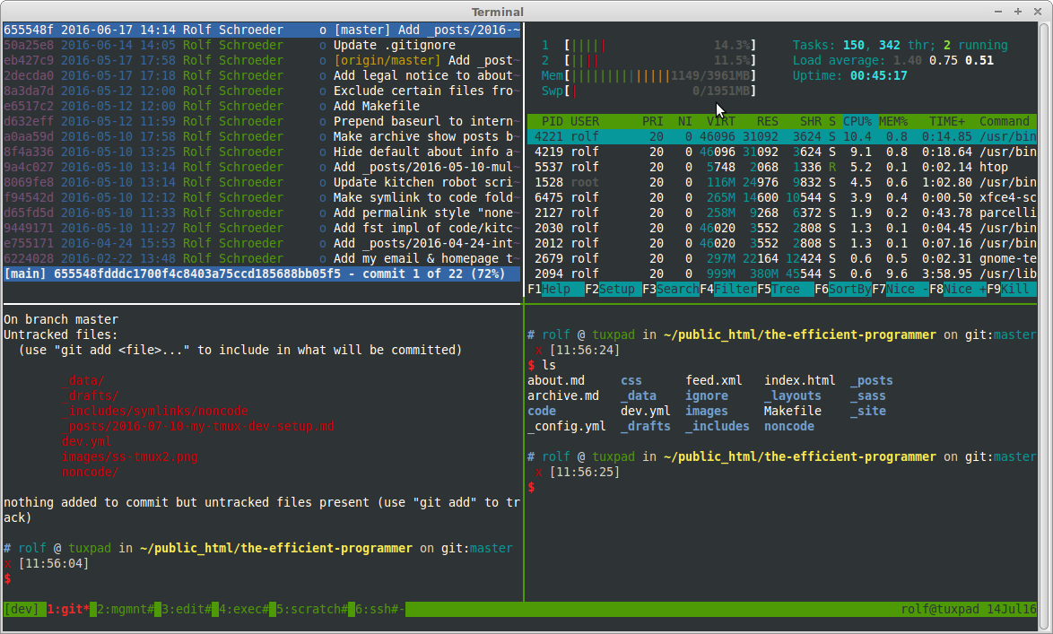
Terminal Tools : Multiplexers + Shells
Multiplexers: multiple terminals in one window
Tmux, Screen, Terminator
Shells: sh, bash, zsh, fish, dash

Slide 9
Terminal Tools : Upgrades
Upgrades: faster, easier to use, more fully featured
ripgrep: replaces grep
built on Rust’s regex engine
Ignores binaries, .gitignore files, etc. by default
Recursive by default
Usage: rg <expression>
fd: replaces find
Way more convenient syntax
Usage: fd <filename> vs. find . –name <filename>
bat: “a cat(1) clone with wings”
Adds colors, git integration, line numbers
Paging, style, syntax, and theming options
Notes:
Both of these take care of the obvious exlcusions, like binaries and stuff in .gitignore folder, etc.
Show fuzzy example with folders as well as git diff

Slide 10
Terminal Tools : Extensions
Extensions
fzf: general purpose fuzzy finder
great when you are a little “fuzzy” on what you’re looking for
Use on filesystem, or pipe data from another program!
Great with git log, git diff, rg/grep, fd/find
autojump: “a cd command that learns”
Easily navigate to far off directories without providing full paths
Weight directories the more you use them

Slide 11
Terminal Tools : There’s a tool for that!
Don’t see what you’re looking for?
These are just some examples that I find very useful, next time you’re “in the field”, think about what tools could make your life better:
“It would be cool if I could ______ “
“This is going to take forever, I wish I could just _______”
“Ugh, now I’m going to have to do that again, I wonder if there’s a way to _______”
Chances are, there’s a tool for that!
If not, there’s a chain of tools that you could use, turn into a function, and use to make your life easier.
If you don’t want to figure it out right now, start keeping a list of things you’d like to research for later
If not, make your own!

Slide 12
Terminal Tools : Scripting and Aliases
Anytime you find a new command that takes up more than a few words, create a function / script for it!
Keep a bin full of scripts! (~/bin)
I’ll start off with specific names like fix_flites_makefiles.sh
If it’s something I end up using a lot, I’ll shorten that to ffm
This also results in a great catalog of commands you’ve used before and how you’ve used them (avoid going back down the Google purple-search-trial)
Use aliases to shorten commands you use a lot:
alias em=’emacs -nw’
alias gdm=’git diff master’

Slide 13




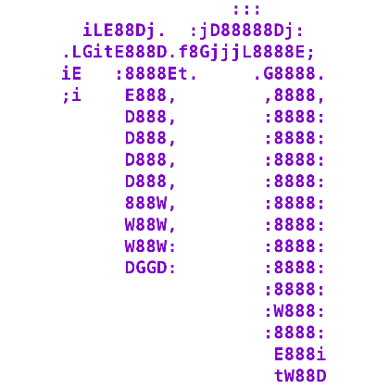


Editors
Notes:
Now, I’m not going to try to convince you any editor is best, because there isn’t a best editor. It depends on how you work and just what you are comfortable, so I suggest you try a couple and see what you like best. Don’t let anyone tell you one editor is superior over another.

Slide 14
Editors
True hackers only
$$$$
Used by the pros!!
Make you good programmer!!
Just no

Slide 15
Editors : What makes a good editor?
Key-bindings
Defaults and ability to modify
Extensibility
How easy settings are to change
What extensions, add ons are available
Ubiquity
What systems is it available on
User experience
Learning curve
Ease of installing extensions, configurations
Integration with terminal

Slide 16
Editors : Origins
Vim: modal text editor released in 1991
Derived from vi which was created in 1976
“Vim uses distinct editing modes. Under "insert mode", keys insert characters into the document. Under "normal mode" (also known as "command mode"), bare keypresses execute Vim commands.”

Slide 17
Editors : Origins
Vim: modal text editor released in 1991
Derived from vi which was created in 1976
“Vim uses distinct editing modes. Under "insert mode", keys insert characters into the document. Under "normal mode" (also known as "command mode"), bare keypresses execute Vim commands.”
Emacs: non-modal editor released in 1985
“Emacs uses metakey chords. Keys or key chords can be defined as prefix keys, which put Emacs into a mode where it waits for additional key presses that constitute a key binding. Key bindings can be mode-specific, further customizing the interaction style. Emacs provides a command line accessed by M-x that can be configured to autocomplete in various ways.”

Slide 18
Editors : Modern Text Editors
Descendants of Vim/Emacs
Neovim, Spacemacs
Integrated Development Environments (IDE)
IntelliJ, Eclipse, Visual Studios
Lightweight Editors
Sublime, Atom, Nano
Visual Studios Code (VSCode)
In just 4 years, VSCode has managed to take up 50.7% of the text editor market, with Visual Studios at 31.5% and Vim at 25.4%
StackOverflow Developer survey

Slide 19
Editors : So which one should you use?
I would try to start with Vim or Emacs, to get a feel for the different approaches to editing, and see which you like better.
It’s nice to have a basic understanding of both these editors, as they are tried and true, and will be available on most (Emacs) if not all (Vim) machines that you encounter.
In addition, modern editors like VSCode, Sublime, etc. will have extensions that like you use your choice of Vim or Emacs key-bindings.
Notes:
* When I first joined, I wanted to be cool like Conrad and use Vim, but I just couldn’t get into it, I found myself going in and out of modes constantly, and just didn’t feel efficient. Then, Julia introduced me to Emacs, and it made sense to me immediately, because that’s my style of coding, I’m selecting lines and words in lines and cutting and pasting them and moving them around, and jumping between files a lot.

Slide 20
Editors : The Case for VSCode
Flexibility: VSCode can be anything you want, and it can do it well. You’ll be able to use it across all machines, languages, and projects while maintaining key-bindings, preferences, and themes with ease.
Extension Marketplace: VSCode is being rapidly adopted by the community, and there are extensions for pretty much anything you can imagine.
Ease of Use: changing key-bindings, adding extensions, launching new shells, running tasks, etc. is all so easy.

Slide 21
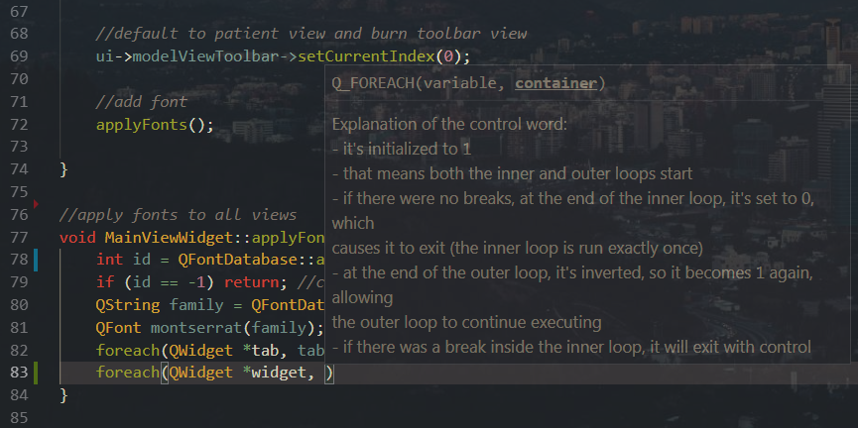
Editors : The Case for VSCode

Slide 22
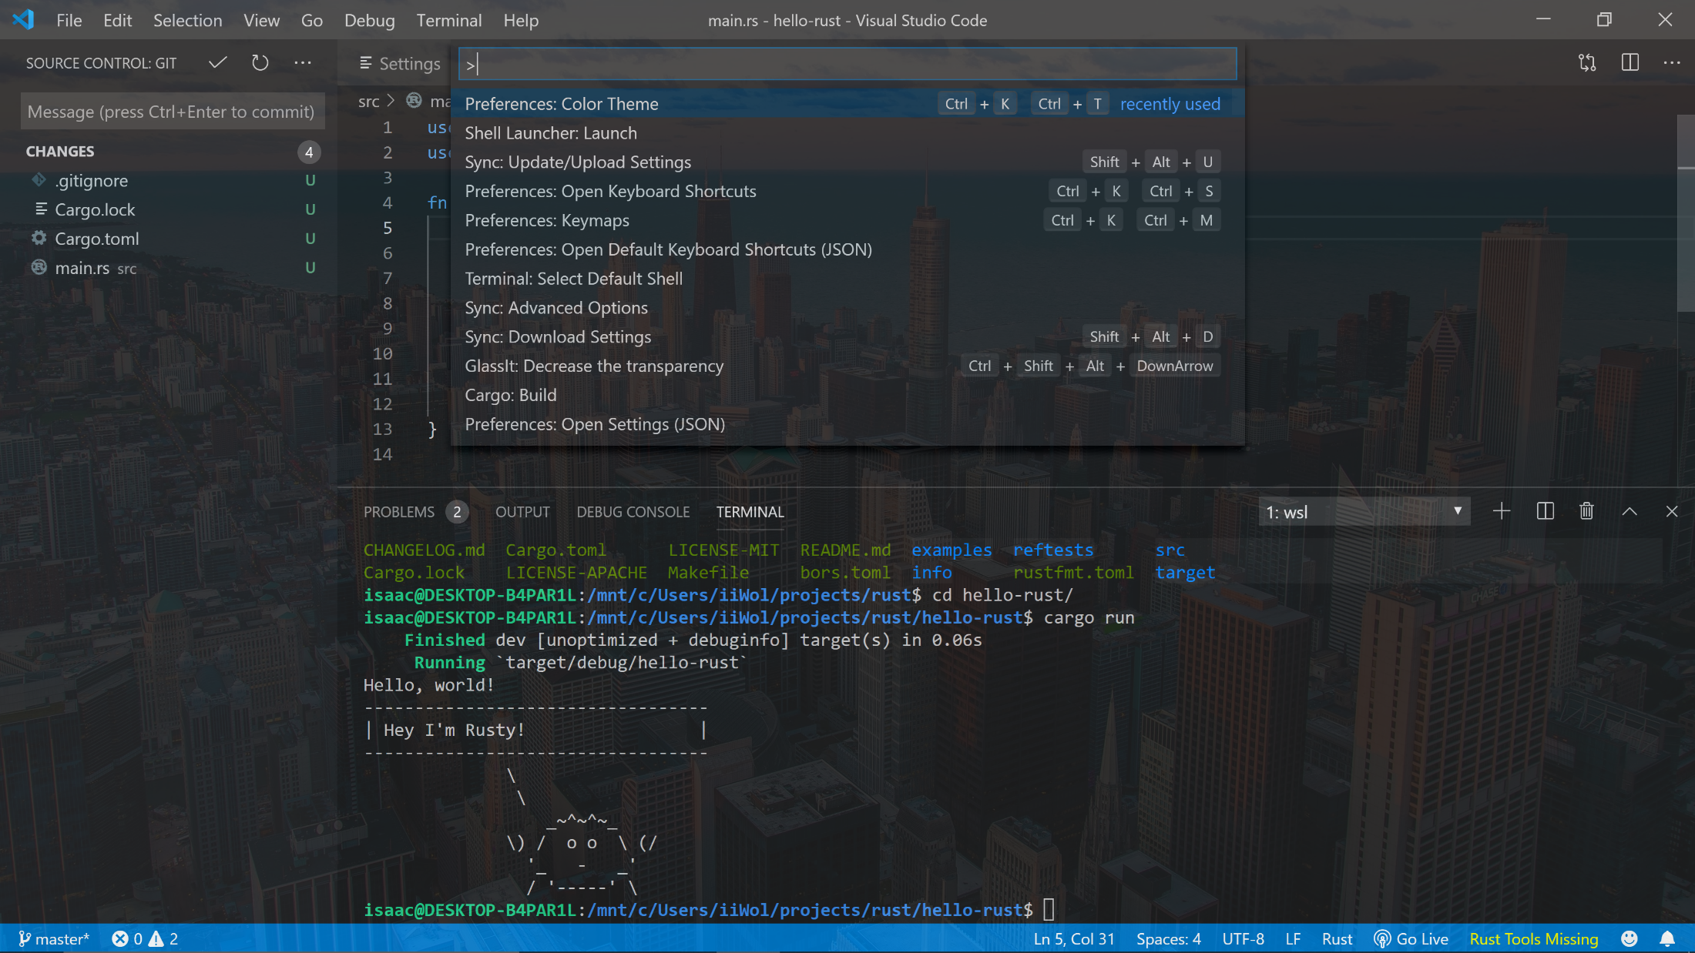
Editors : The Case for VSCode

Slide 23
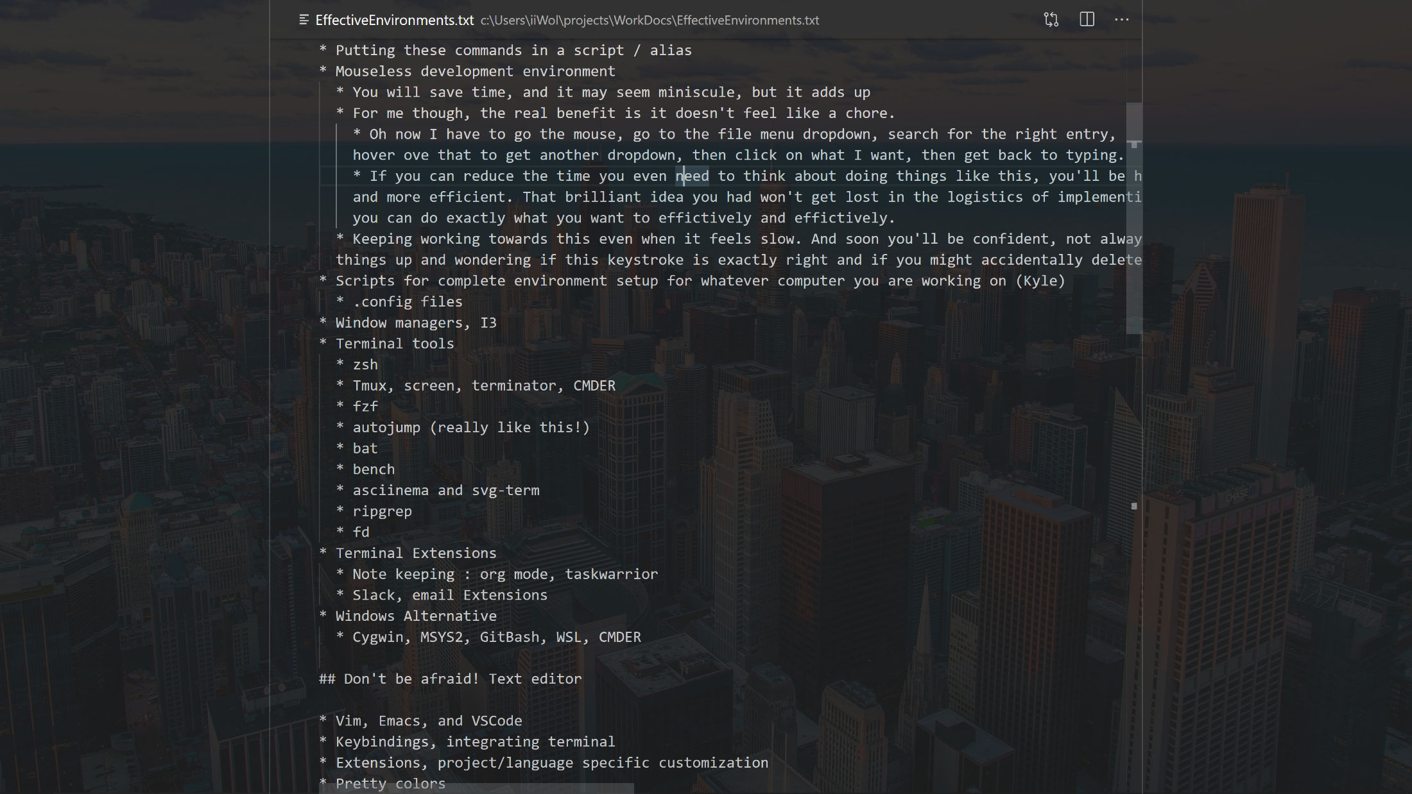
Editors : The Case for VSCode

Slide 24
Editors : Key-bindings
Tab / Terminal / Window Navigation
Cycle between tabs (Alt + Arrow Key)
Jump from editor to terminal (Alt + Arrow Key / Ctrl + z)
Split editor / terminal (Ctrl + x + 2/3)
Open new window / terminal (Ctrl + x + f)
Text Navigation
Start/end of line (Ctrl + a/e)
Start/end of paragraph (Ctrl + up/down)
Up/down page (Ctrl + v / Alt + v)
Search up/down (Ctrl + s / r)
Text Manipulation
Cut/Copy/Paste/Yank selection or line (Ctrl + W / Alt + W / Ctrl + Y)
Move line(s) (Ctrl + Alt + Arrow Keys)
Multiline type/select (Ctrl + Shift + Arrow Keys)
Notes:
I always used to find myself furiously scrolling or down-paging thinking, “I know that line is right here somewhere” – make search easy for you, it’ll take you exactly where you need to go!
Multiline type is pretty wild in VSCode, and comes up more than you’d think. Again this is the kind of stuff that just might get you over that hump, so you go from, “Ugh, I need a break, I’ll try this later” to, “Ok, let me just try this quick, BAM it worked I’m done”

Slide 25
Editors : Coupling the Terminal & Editor
Whether it’s integrating your terminal into your editor, or integrating your editor into your terminal, it’s important to be able to jump back and forth quickly, making the switch from editing text to compiling and debugging code quick and painless
In Vim this is all taken care of because Vim is in the terminal
You can create your own custom commands to make these process even quicker!
Likewise, using ‘emacs –nw’ you can open Emacs inside the terminal
Alternatively, you can open a terminal inside Emacs
You can also create custom commands that run with M-x or your chosen key-binding

Slide 26
General environment tips
Key-bindings Everywhere and Syncing Settings

Slide 27
General Environment Tips : Keybindings Everywhere!
Key-bindings aren’t just for the terminal and editor, spend some time learning keybindings to navigate your workspace, browser, and OS in general
Navigate windows: Alt + Tab
In Ubuntu:
Launch commands: Alt + F2
New terminal: Ctrl + Alt + T
Switch workspace: Ctrl + Shift + Arrow Keys
Most browsers have similar commands
New Tab : Ctrl + N
Cycle Tabs : Ctrl + Tab (Ctrl + Shift + Tab to go backwards)
Go to Address Bar : Ctrl + E
Comparison Table for browsers :
http://dmcritchie.mvps.org/firefox/keyboard.htm

Slide 28
General Environment Tips : Settings Sync
So now you’ve installed 37 different terminal extensions and spent hours perfecting your key-bindings. And now you get a new machine…or you have to work on a remote system…or you have to spin up a new virtual machine for a new project…or you’re working from home and your setup there isn’t quite as pristine
This is inevitable, it will happen at some point! And you will get a few of the major items but forgo getting your full setup again
Time to sync those dotfiles!

Slide 29
General Environment Tips : Settings Sync
Add your dotfiles to a personal GitLab/Hub repo
.config, .ssh, .emacs/init.el, .bashrc, .zshrc
This also allows you to test other people’s setups!
Symlinks, GNU Stow, rsync
Create scripts to install all your desired packages, and set up your environment how you like it
Use VSCode settings sync:
I use this across 6 different machines with Windows 7, 10 and Linux operating systems
You can actually add pragmas to apply different settings depending on OS and host machine name!

Slide 30
what’s cookin’ good lookin’?
The Most Important Part of Effective Work Environments

Slide 31
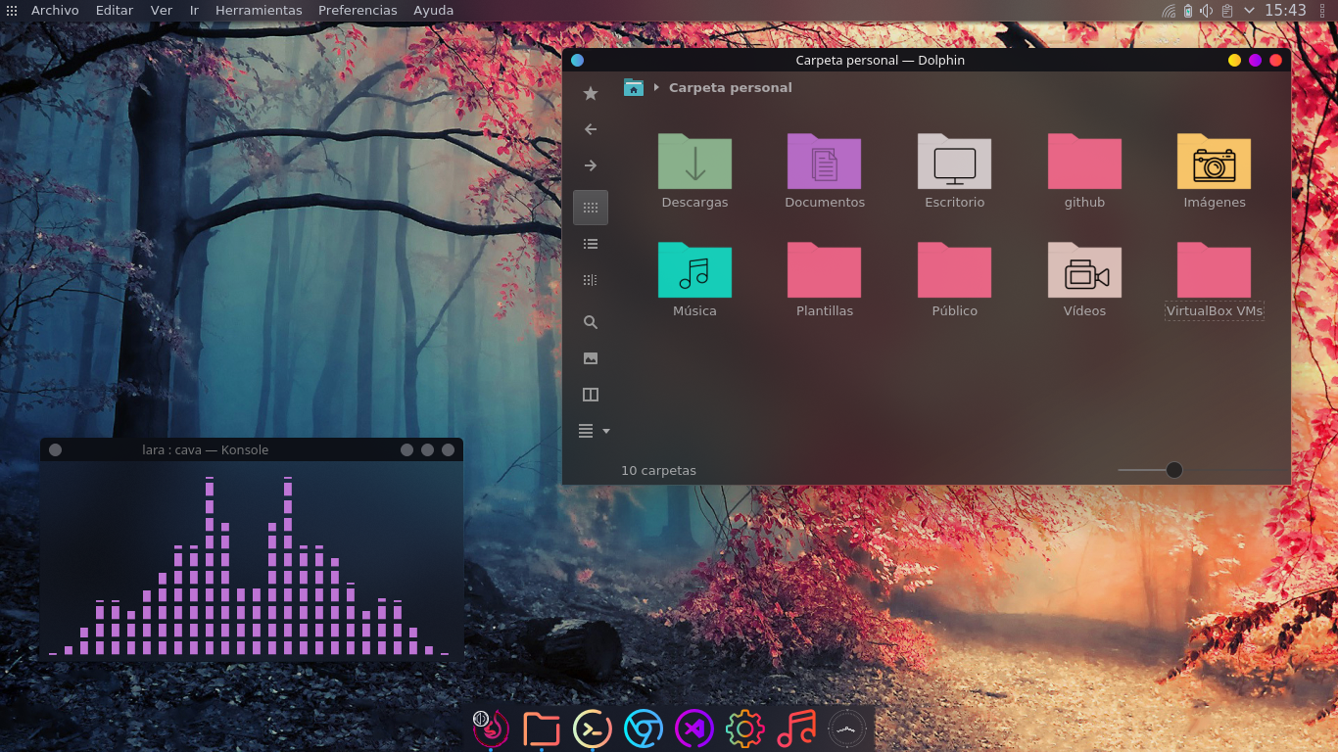

Slide 32
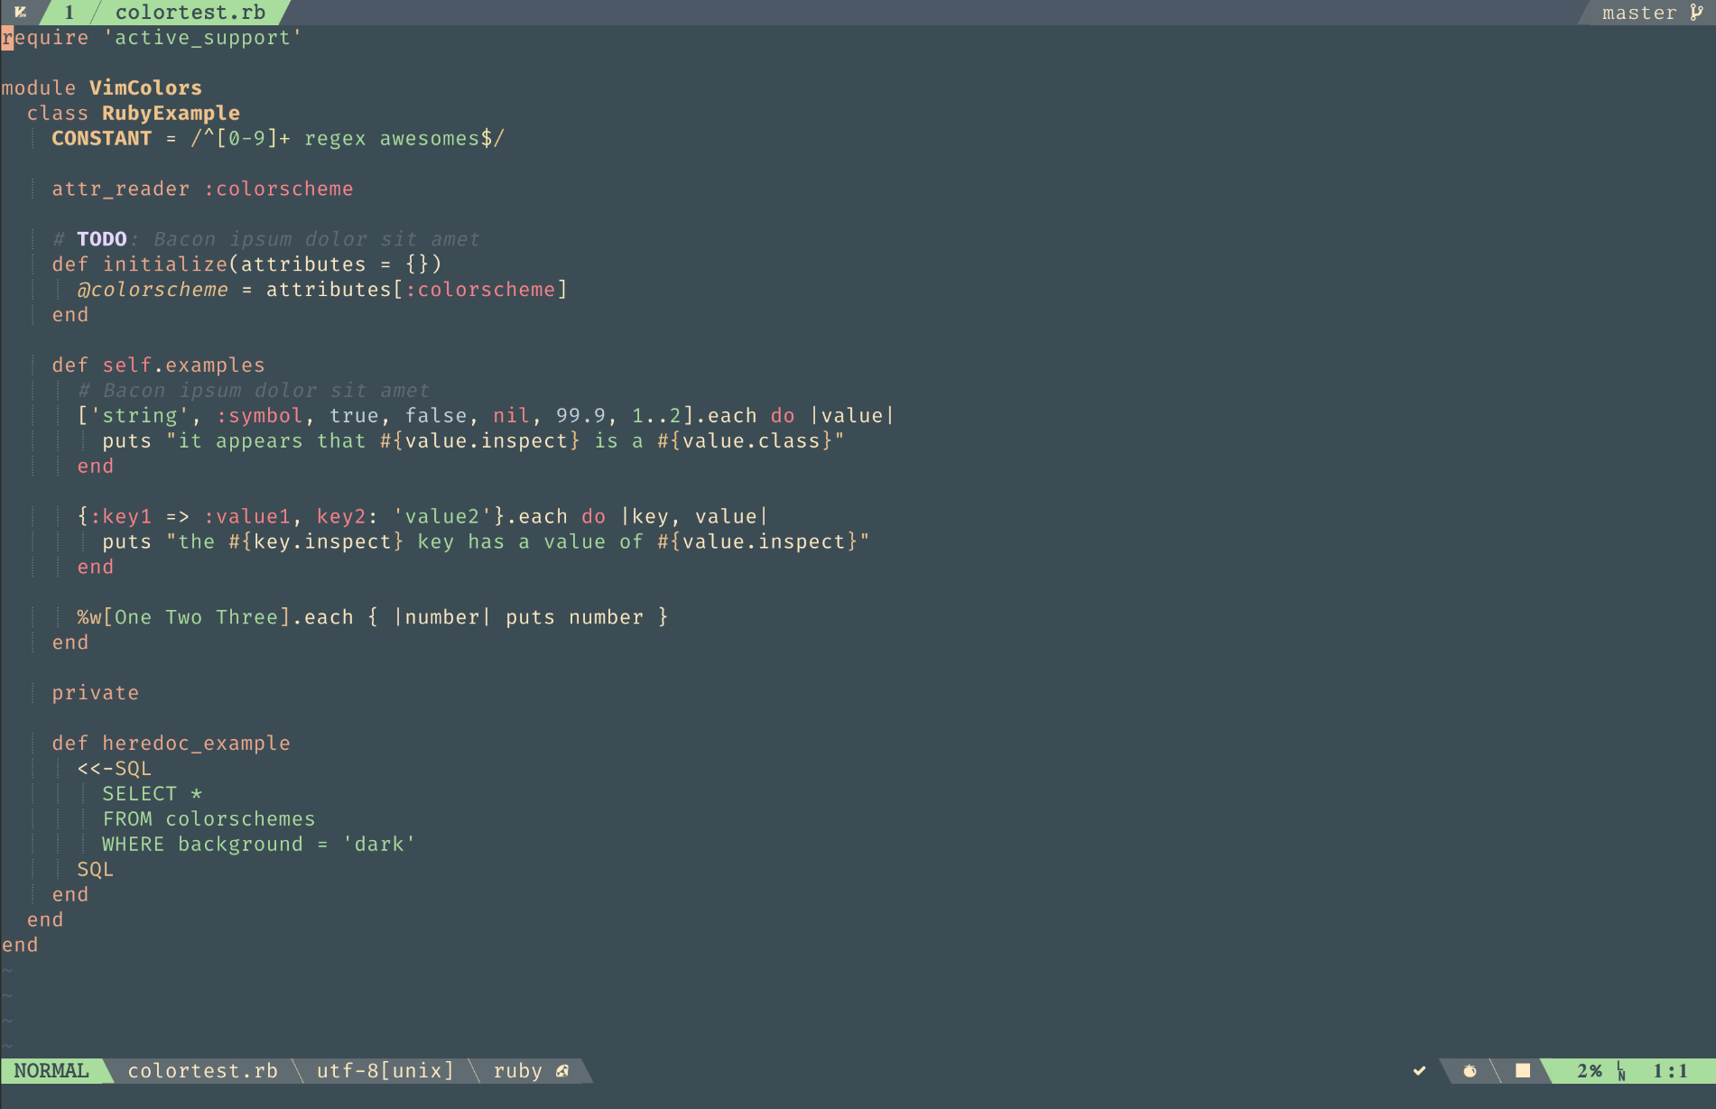

Slide 33
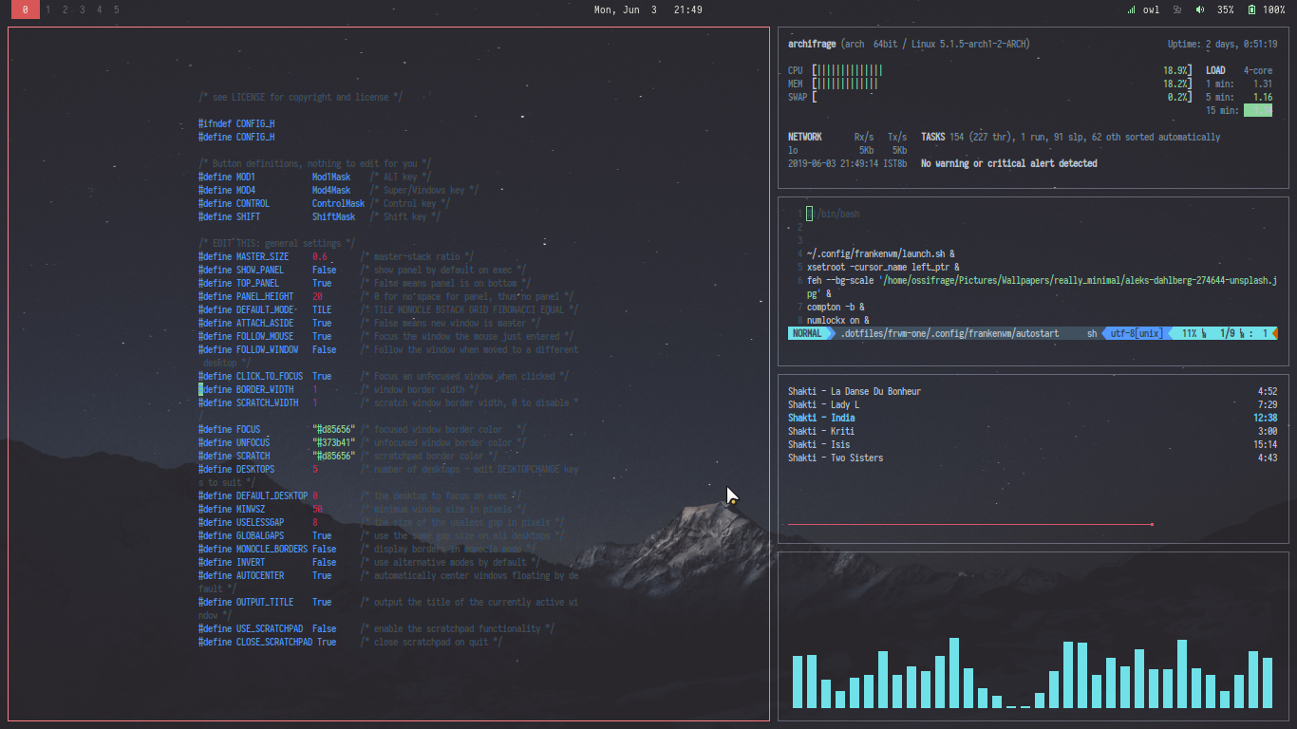

Slide 34
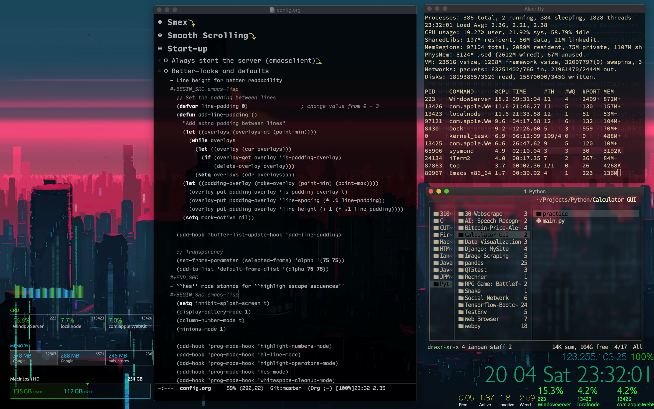

Slide 35
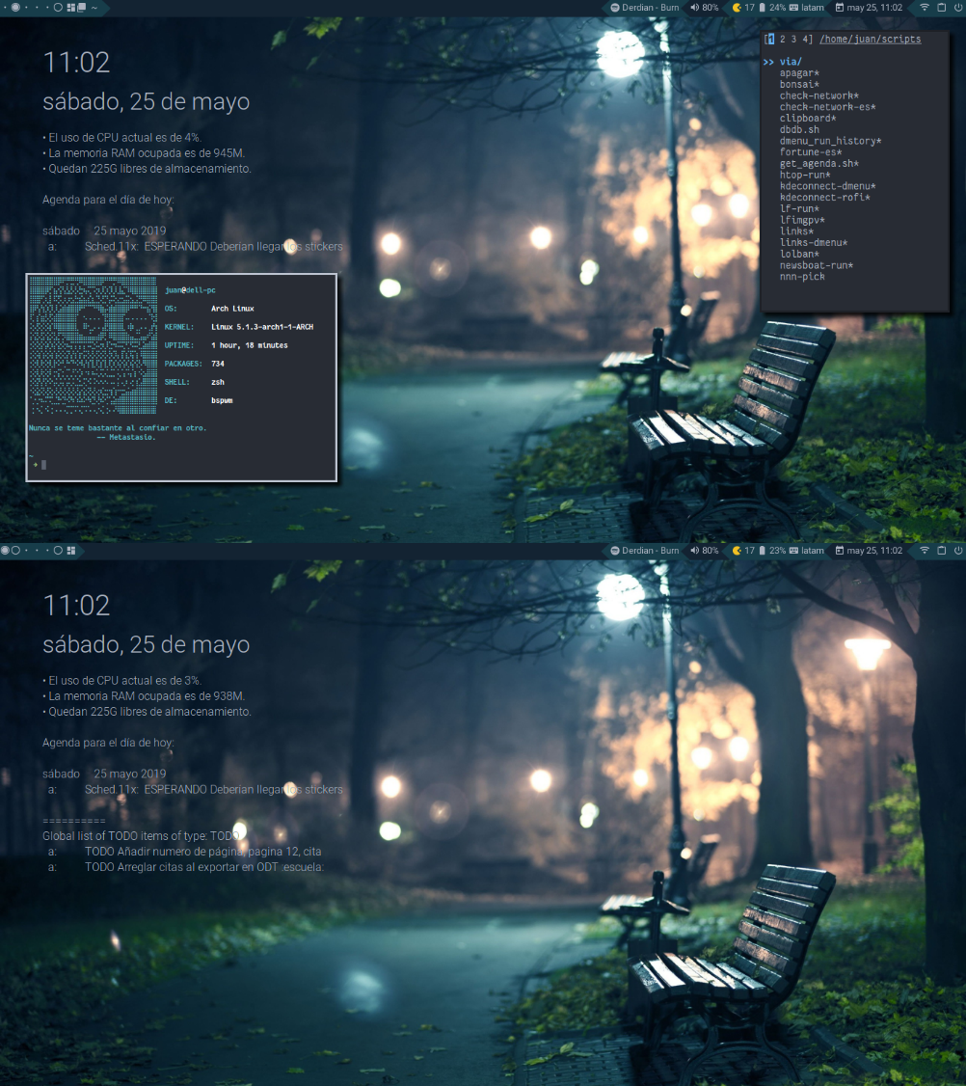

Slide 36
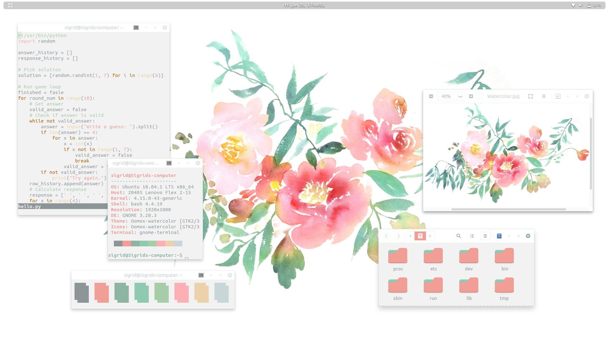

Slide 37
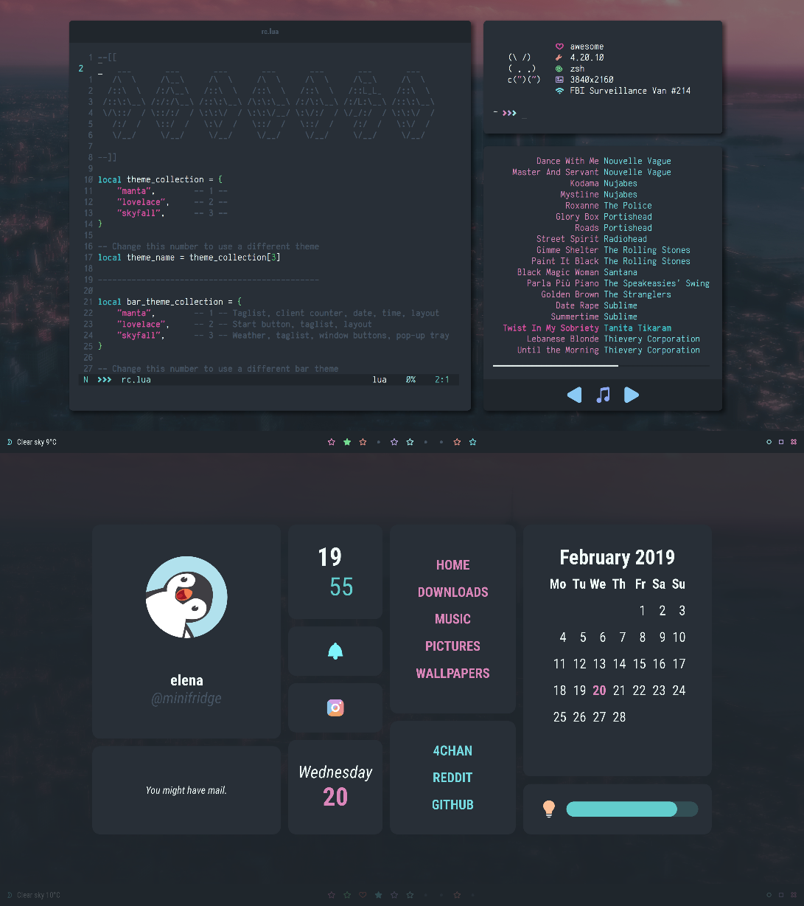

Slide 38
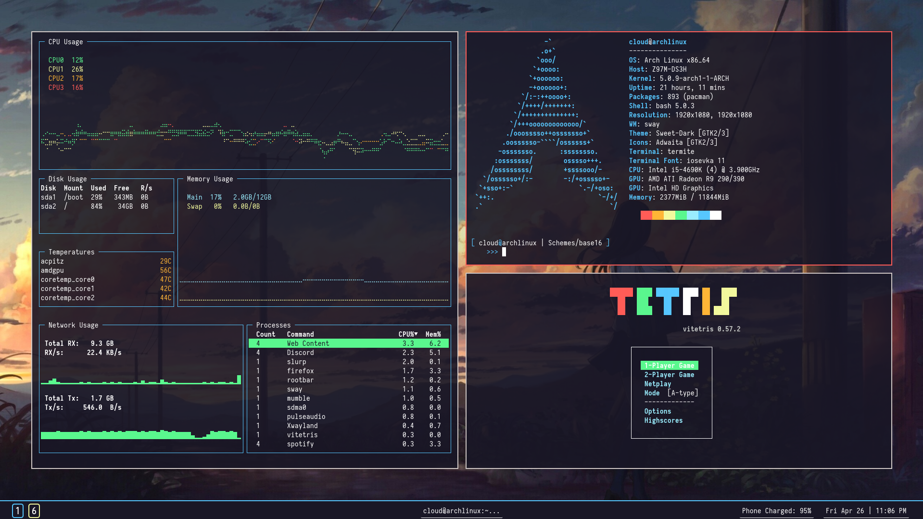

Slide 39
Links!

Slide 40
Links : Terminal Tools
Terminal Upgrades:
ripgrep : https://github.com/BurntSushi/ripgrep
fd : https://github.com/sharkdp/fd
bat : https://github.com/sharkdp/bat
fzf : https://github.com/junegunn/fzf
autojump : https://github.com/wting/autojump
Shell Frameworks / Terminal Managers
Oh-My-ZSH : https://ohmyz.sh/
Tmux: https://computingforgeeks.com/linux-tmux-cheat-sheet/
Terminator: https://terminator-gtk3.readthedocs.io/en/latest/
Screen: https://linuxize.com/post/how-to-use-linux-screen/

Slide 41
Links : Windows Linux Alternatives
Windows Alternatives
Cygwin : https://www.cygwin.com/
MSYS2 : http://www.msys2.org/
CMDER: https://cmder.net/
More info:
Cygwin vs MinGW : https://stackoverflow.com/questions/771756/what-is-the-difference-between-cygwin-and-mingw

Slide 42
Links : Syncing Dotfiles
Guides
GitHub dotfile guide: https://dotfiles.github.io/
Dive Into Dotfiles: https://www.freecodecamp.org/news/dive-into-dotfiles-part-2-6321b4a73608/
Specific Tools
GNU Stow: https://www.gnu.org/software/stow/
rsync: https://linux.die.net/man/1/rsync
VSCode Settings Sync Extension
https://marketplace.visualstudio.com/items?itemName=Shan.code-settings-sync

Slide 43
Links : Misc
StackOverflow surveys:
https://insights.stackoverflow.com/survey/2019
Other effective development environment talks:
https://thevaluable.dev/efficient-development-environment/
https://char.gd/blog/2017/how-to-set-up-the-perfect-modern-dev-environment-on-windows
Terminal tools “Top X” lists:
https://www.endpoint.com/blog/2015/11/04/favourite-unix-command-line-tools
https://itnext.io/10-cli-tools-that-you-will-love-d214bc73d856
https://github.com/agarrharr/awesome-cli-apps
https://www.tecmint.com/cool-linux-commandline-tools-for-terminal/

